Slide 1
GCSE History

Slide 2
Why study History?
It is highly regarded by universities and employers
You can gain skills to help you do better in other subjects
You can develop your skills as inquiring, curious and critical thinkers
It can spark a lifelong interest in making sense of the past

Slide 3
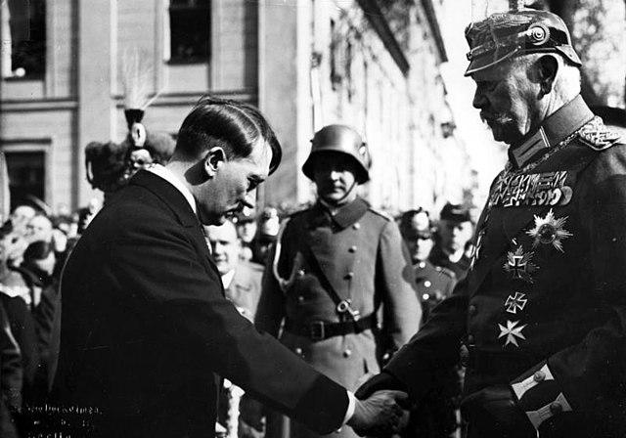
What will I study?
Year 11
Unit 1: Modern World Studies in Depth
Section A
Life in Nazi Germany,1933-45
This includes:
how Hitler became a dictator, how Nazi rule affected the lives of young people, women and minority groups, life in Germany during WWII

Slide 4
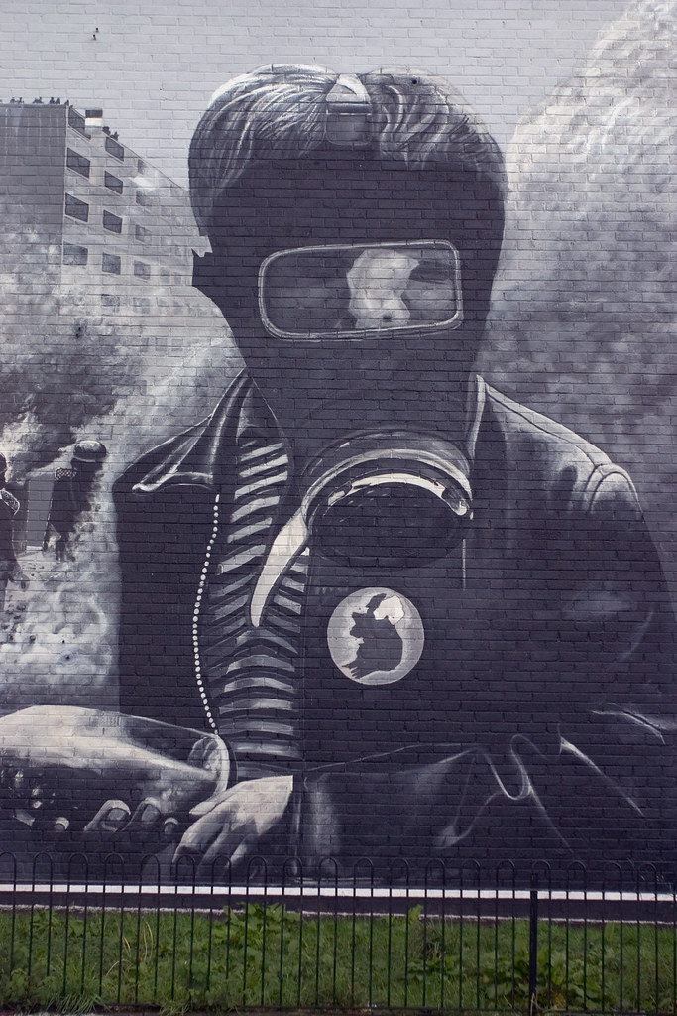
What will I study?
Year 11
Unit 1: Modern World Studies in Depth
Section B
Changing Relations: Northern Ireland and its neighbours 1965-1998
This includes:
The reasons for the outbreak of ‘The Troubles’, the emergence of paramilitary groups, the Hunger Strikes, attempts to find a political solution e.g. The Good Friday Agreement.

Slide 5

What will I study?
Year 12
Unit 2: Outline Study
International Relations, 1945-2003
This includes:
The rivalry between Communism and Capitalism, The Cold War and conflict in Korea, Cuba and Vietnam, The Berlin Wall, fall of Communism, the growth of international terrorism e.g. attacks on the Twin Towers in the USA.

Slide 6
How will I be assessed?
One written paper at the end of Year 11 assessing Germany and Northern Ireland, worth 60%. The exam is 1 hour 45 minutes long.
One written paper at the end of Year 12 assessing International Relations, worth 40%. The exam is 1 hour 15 minutes long.

Slide 7
How can I find out more?
Email Mrs Speers if you have any questions: fspeers638@c2kni.net
Speak to someone in Year 11 or 12 who is already studying History!

